Slide 1

SMART EMERGENCY PATIENT COORDINATION SYSTEM
CSA0203 – C Programming
Presented by:
V.Vijay(192525264) A Guna Sekar(192525302) P V Rahul Kavi(192571090)

Slide 2


Problem Statement
Hospital receives patients from multiple registration counters simultaneously.
Each patient has:
Patient ID
Emergency level
Symptoms
Assigned doctor
Treatment status
Multiple departments may access the same patient simultaneously.
This can cause:
Data conflicts
Lost updates
Incorrect patient information
Record corruption

Slide 3
Objectives
Develop a reliable emergency patient coordination system.
Dynamically allocate memory for patient records.
Use functions for patient operations.
Use pointers to modify records.
Use threads to simulate hospital departments.
Use mutexes for safe concurrent updates.
Store patient history in files.
Use command-line arguments for department configuration.
Use IPC to transfer emergency information.

Slide 4
Proposed System
Centralized patient record management.
Multiple departments can work simultaneously.
Departments include:
Registration
Emergency/Triage
Doctor/Treatment
Pharmacy
Discharge
Real-time coordination between departments.
Patient records are protected during updates.
Complete history is maintained for every patient.

Slide 5
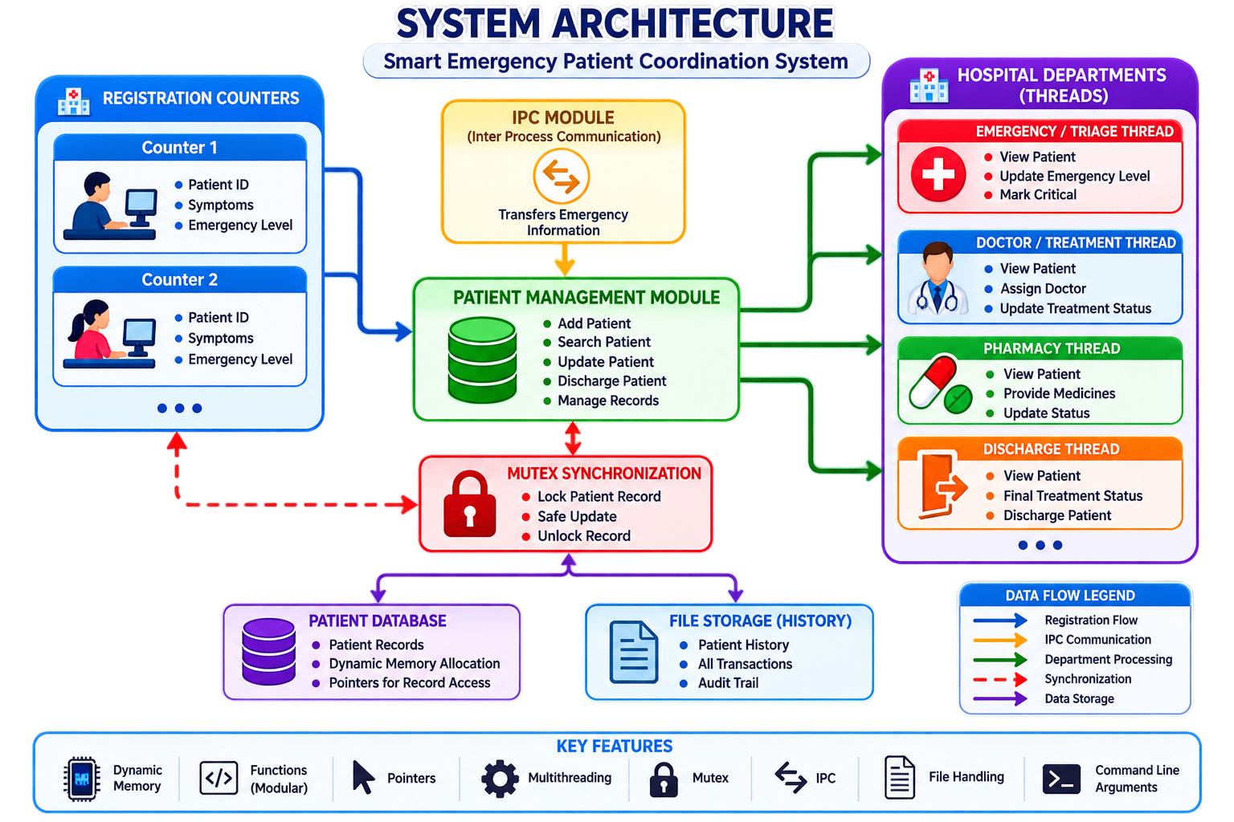

Slide 6
Patient Data Management
C Structures – Store complete patient records.
Patient Information – ID, emergency level, symptoms, doctor, and treatment status.
Dynamic Memory Allocation – Allocates memory as patients are added.
Core Functions – Register, Search, Update, and Discharge patients.
Pointers – Used to efficiently access and modify patient records.
Benefit – Flexible and efficient patient data management.

Slide 7
Multithreading
POSIX threads are used to simulate hospital departments.
Each department operates as a separate thread.
Example:
Registration Thread
Emergency Thread
Doctor Thread
Pharmacy Thread
Discharge Thread
Multiple departments can process different patients simultaneously.
Threads improve system responsiveness.
Shared patient data requires synchronization.

Slide 8
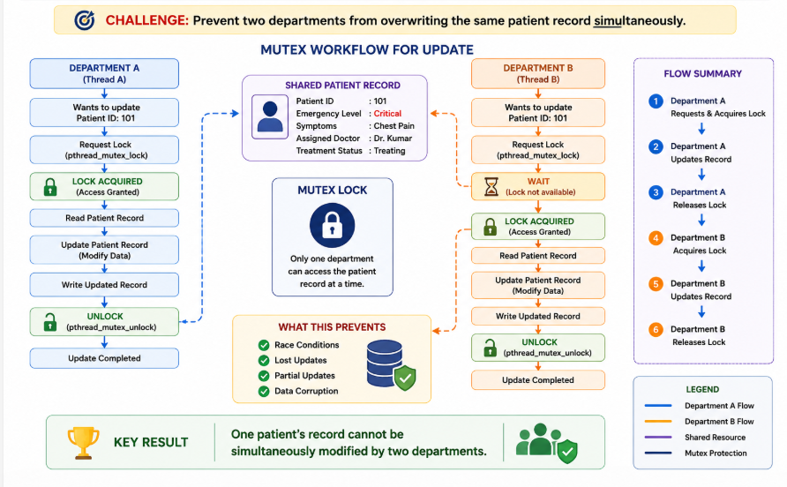
Challenge

Slide 9
IPC & File Handling
IPC connects the registration and treatment modules.
Registration sends:
Patient ID
Emergency level
Symptoms
Treatment module receives the emergency information.
Patient history is stored in a file.
History includes:
Registration
Emergency-level changes
Doctor assignment
Treatment updates
Discharge
Provides an audit trail of patient activities.

Slide 10
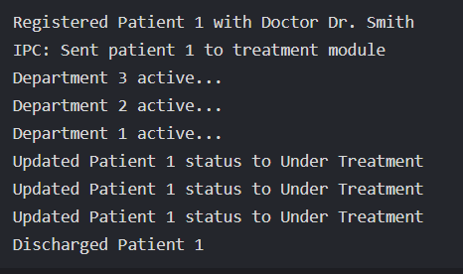
Future Scope
AI-based emergency-level prediction.
IoT-based patient monitoring.
Mobile application.
SMS/emergency notifications.
Cloud-based hospital integration.
Ambulance tracking.
Advanced analytics.
Electronic Health Record integration.

Slide 11
Conclusion
Smart system for coordinating emergency patient information.
Supports multiple hospital departments.
Uses dynamic memory, pointers, functions and threads.
Mutex protects shared patient records.
IPC enables module-to-module communication.
File handling maintains patient history.
Successfully addresses the hackathon challenge.

